Slide 1
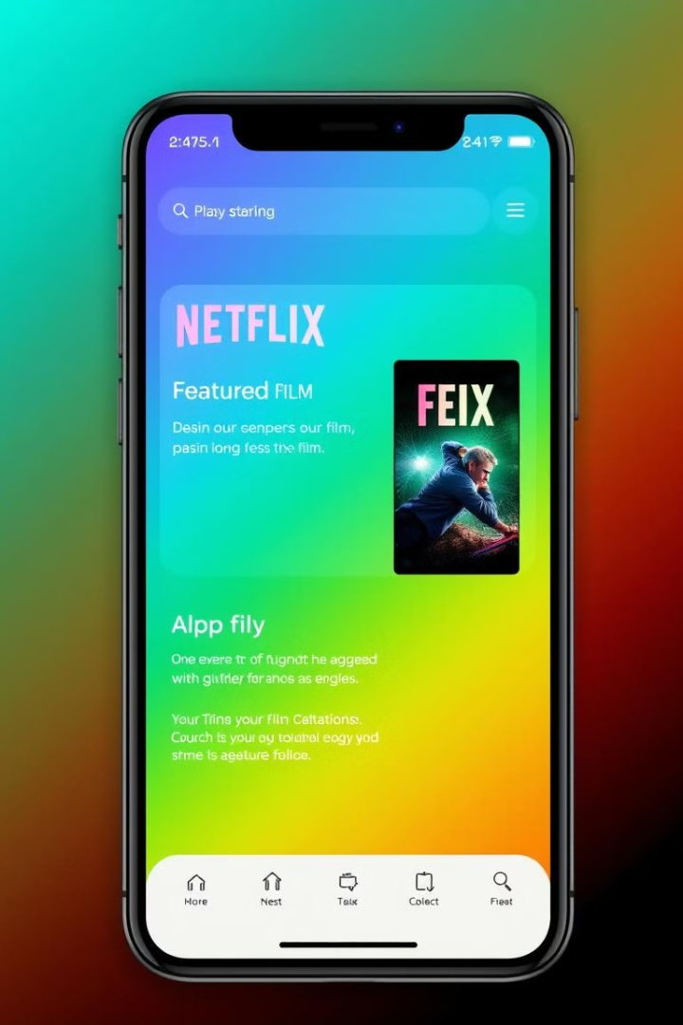

Building a Netflix Clone with HTML and CSS
This presentation outlines the steps involved in building a functional Netflix clone using fundamental HTML and CSS techniques. The focus will be on replicating the essential features and aesthetics of the popular streaming platform, including the main page, header, and footer.
Nitin Kumar

Slide 2

Why Build a Netflix Clone?
1
Learning by Doing
2
Portfolio Project
Building a Netflix clone provides a practical and engaging way to learn and master in core web development principles.
A well-crafted Netflix clone can demonstrate your skills and knowledge to potential employers or clients.
3
Creative Exploration
This project allows you to experiment with design, interactivity, and user experience elements.

Slide 3
HTML and CSS Fundamentals
HTML Structure
CSS Styling
HTML provides the foundation for the web page, defining the content and structure of the layout.
CSS controls the visual presentation of the web page, including colors, fonts, and layout.

Slide 4
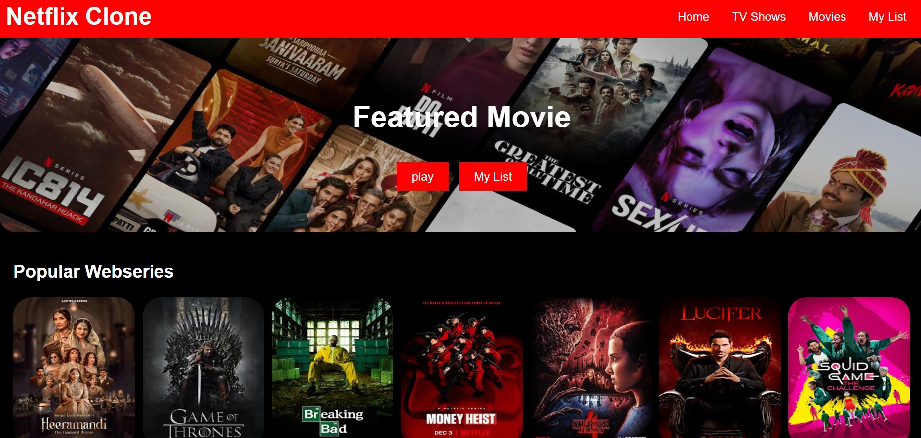

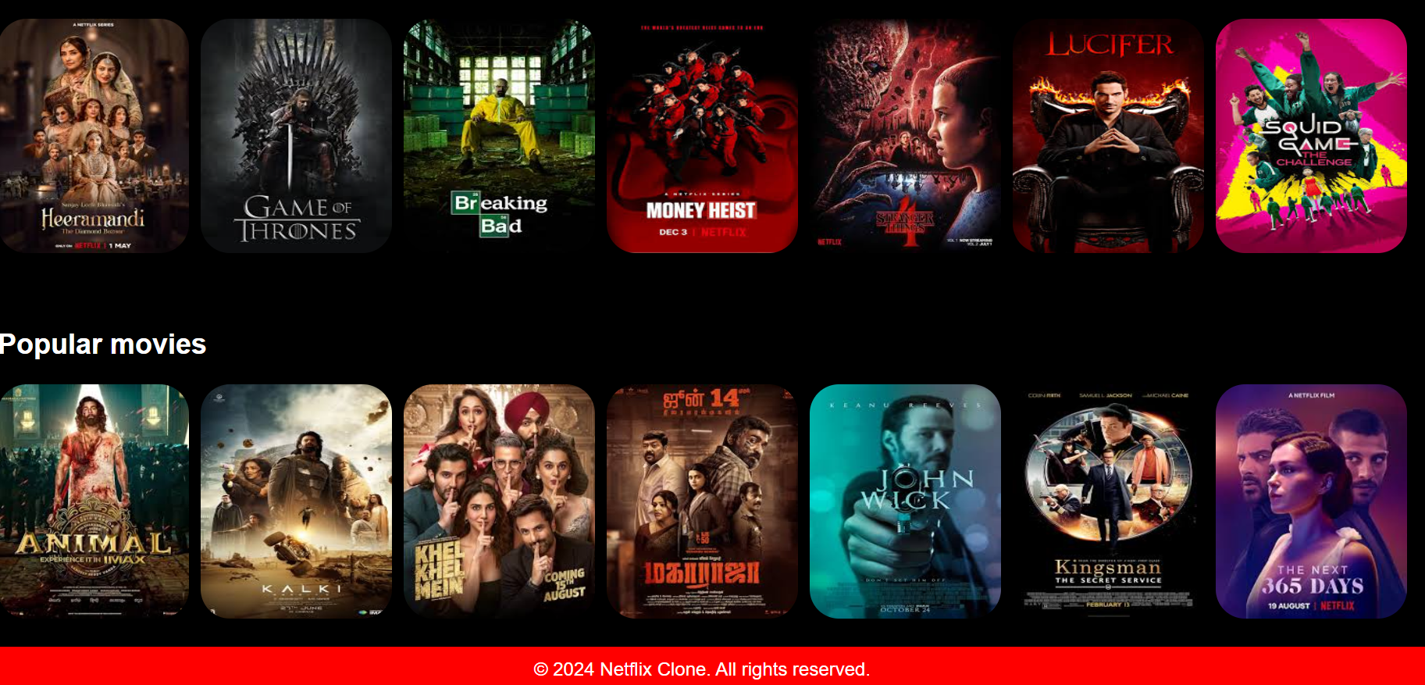


Structuring the Page Layout
Header
The header section typically contains the logo, navigation menu, and search bar.
Main Content
The main content area showcases the featured content, movie recommendations, and browsing categories.
Footer
The footer often displays copyright information, links to policies, and contact details.

Slide 5
Uses of different CSS code to style it
Buttons
Movie card
Boarder-radius
I had used buttons hover so that when we click on it and it color get’s change.
We use movie card option to make and add the space between image of the movies.
We use it to round the all four corners of the movie images.

Slide 6

Creating the main page
Background Image
Anchor tag
The hero section typically features a compelling background image related to the featured content.
We used anchor tag so that in future it will display and take us to other webpages by using JavaScript.

Slide 7





I want to improve it by using scholer by java script
Search Functionality
Video Playback
Implement a search bar to allow users to find specific content.
Integrate video playback functionality using JavaScript libraries like Video.js .
User Accounts
User Settings
Create a system for user accounts, allowing users to save their favorite content, track their viewing history, and manage their profiles.
Provide user settings for adjusting video quality, subtitles, and other preferences.

Slide 8

Thank you
This presentation has explored the foundational steps involved in building a Netflix clone using HTML and CSS. By using these skills and principles, you can create a functional and visually appealing web application that matches the popular streaming platform.

